Slide 1

EDA on Passenger Booking
Presented By :
Kiran Suresh Phondake

Slide 2
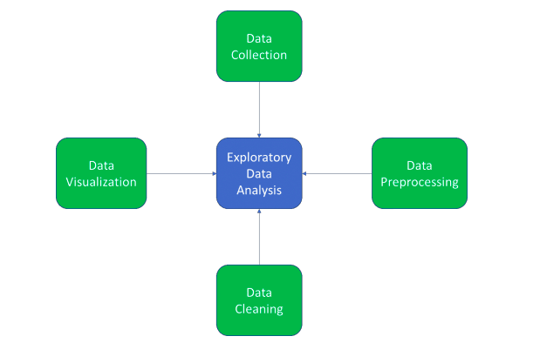
Introduction
Exploratory data analysis (EDA) is used to analyze and investigate data sets and summarize their main characteristics, often employing data visualization methods.
Steps involved in EDA :
Data Collection
Data Preprocessing
Data Cleaning
Data Visualization

Slide 3
Tools and Libraries
Jupyter Notebook : Jupyter Notebook is an open free source web application that is used for data cleaning and transformation, numerical, simulation, statistical modelling, data visualization and so on.
SAS : SAS is a statistical software for data management, advanced analytics, multivariate analysis, business intelligence, criminal investigation, and predictive analytics.
Libraries :
1. Pandas 2. NumPy
3. Matplotlib 4. Seaborn
5. Tableau

Slide 4
Data Collection
Features | Description
num_passengers | No. of passengers travelling
sales_channel | Sales channel booking was made on (Internet or Mobile)
trip_type | trip Type (Round Trip, One Way, Circle Trip)
purchase_lead | No. of days between travel date and booking date
length_of_stay | No. of days spent at destination
flight_hour | hour of flight departure
flight_day | day of week of flight departure
route | Booking origin to destination flight route
booking_origin | country from where booking was made
wants_extra_baggage | if the customer wanted extra baggage in the booking
wants_in_flight_seats | If the customer wanted a preferred seat in the booking
wants_in_flight_meals | if the customer wanted in-flight meals in the booking
flight_duration | total duration of flight (in hours)
booking_complete | flag indicating if the customer completed the booking

Slide 5
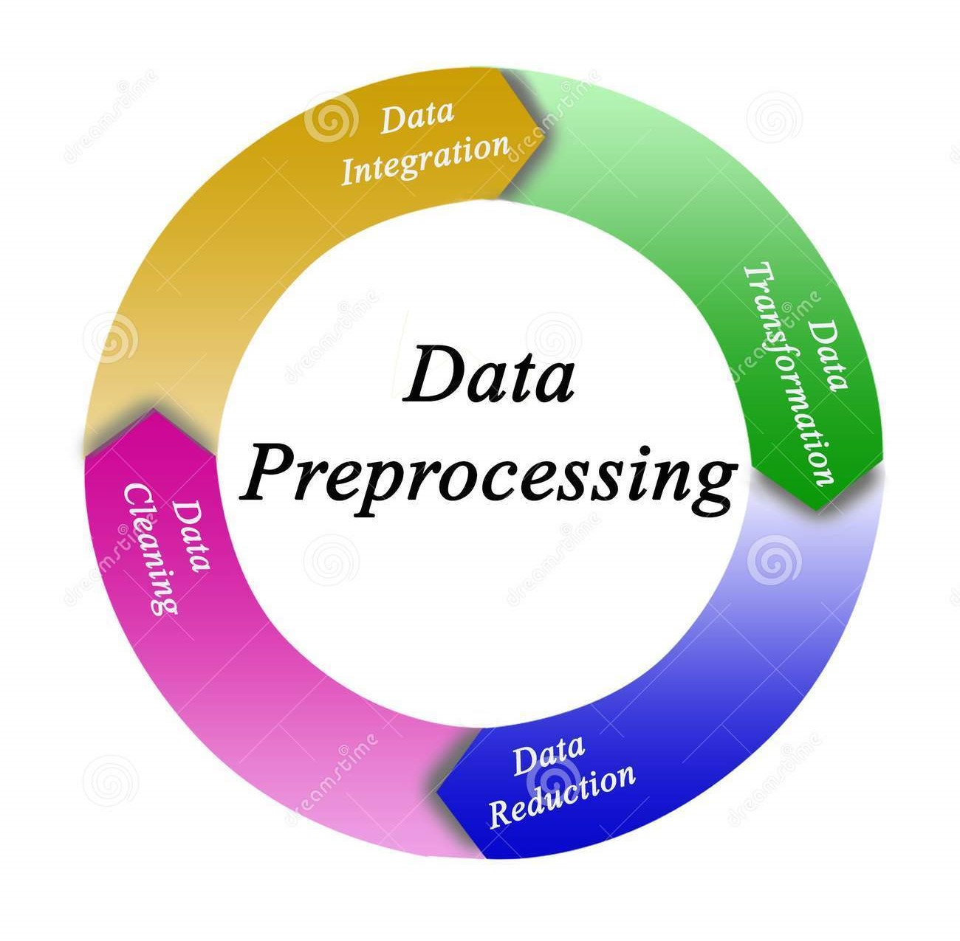
Data Preprocessing
Data preprocessing involves the transformation of the raw dataset into an understandable format. Preprocessing data is a fundamental stage in data mining to improve data efficiency. The data preprocessing methods directly affect the outcomes of any analytic algorithm.

Slide 6
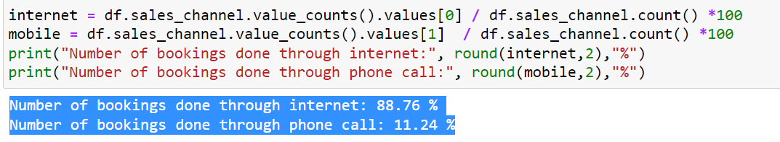
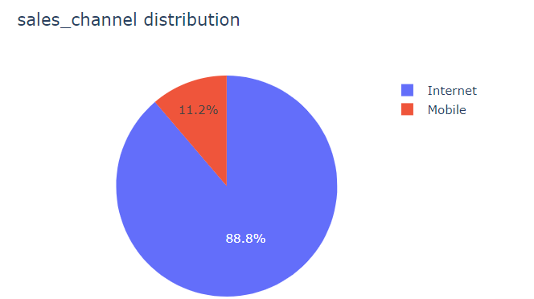
Exploratory Data Analysis
Sales channel : Internet or Mobile
From the below results we observed that more no. of booking done through Internet Channel
Fig. Pie Chart

Slide 7
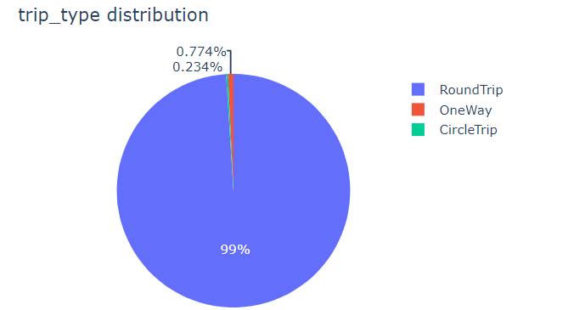
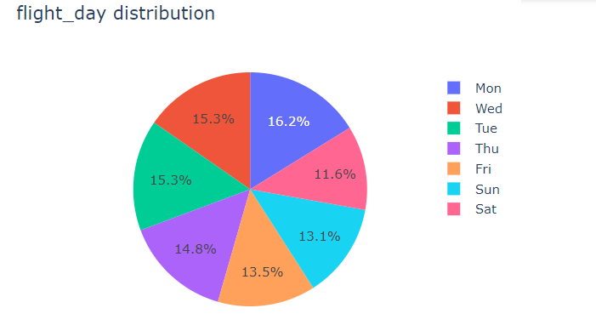
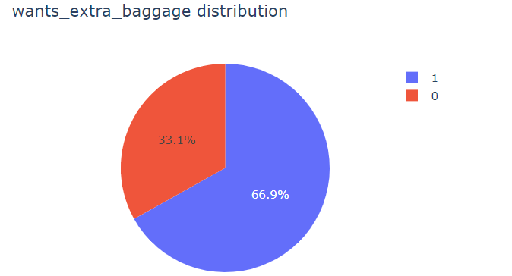
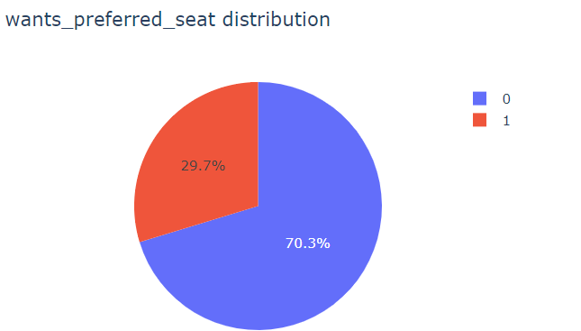
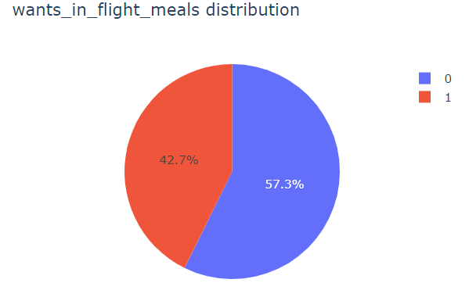
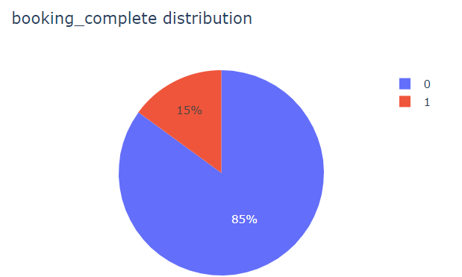
Fig. Pie Charts

Slide 8
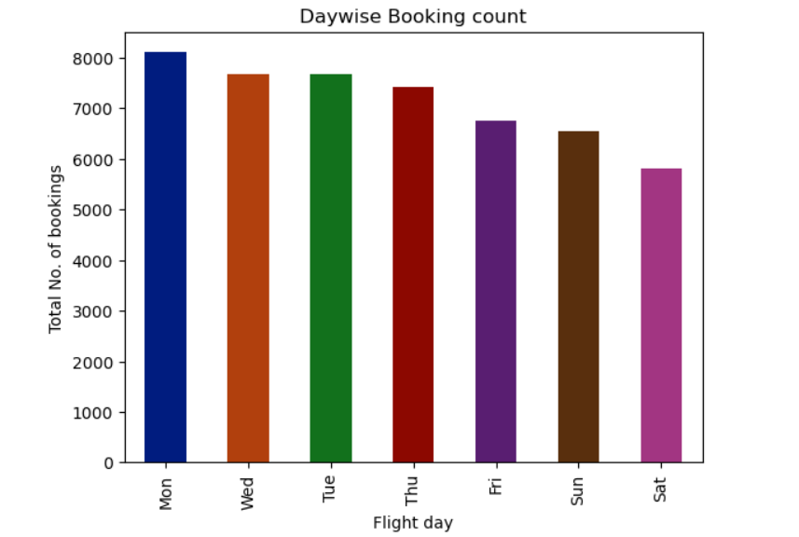
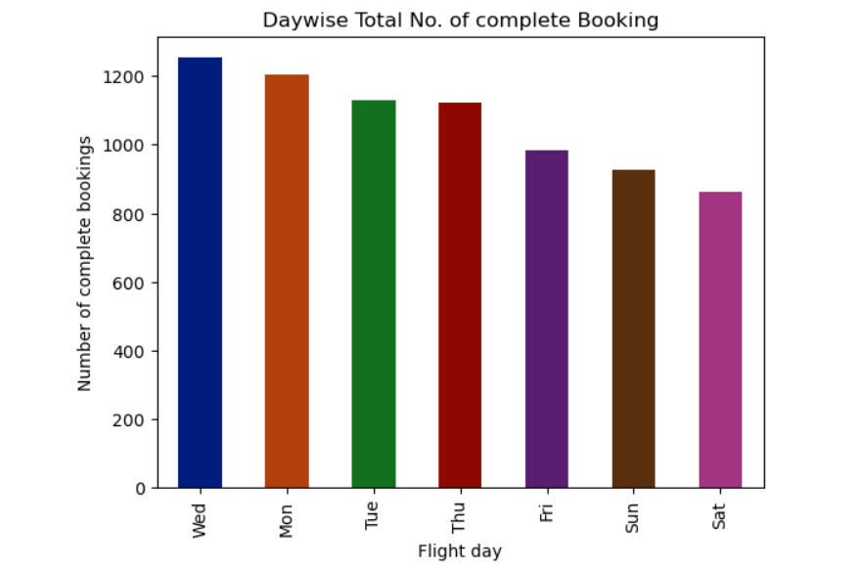
Exploratory Data Analysis
Day wise Total booking count Vs Total No. of complete Booking
Fig. Bar Chart

Slide 9
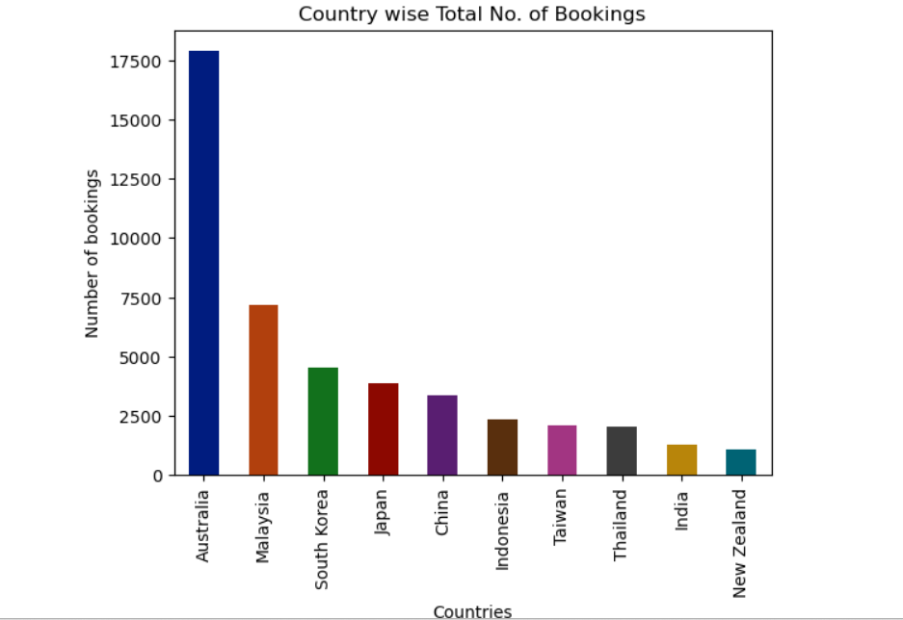
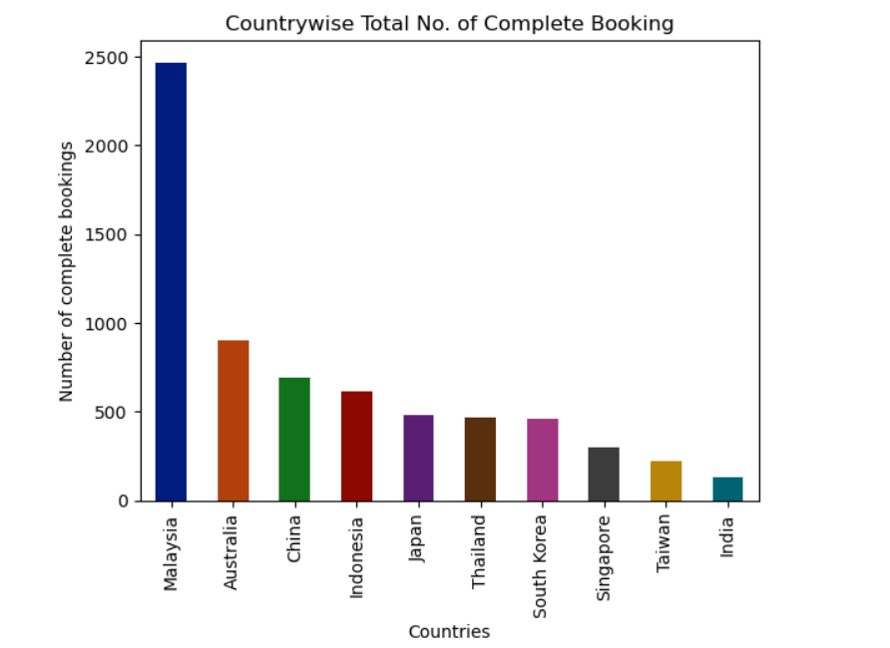
Top 10 countries with highest number of bookings
Fig. Bar Chart

Slide 10
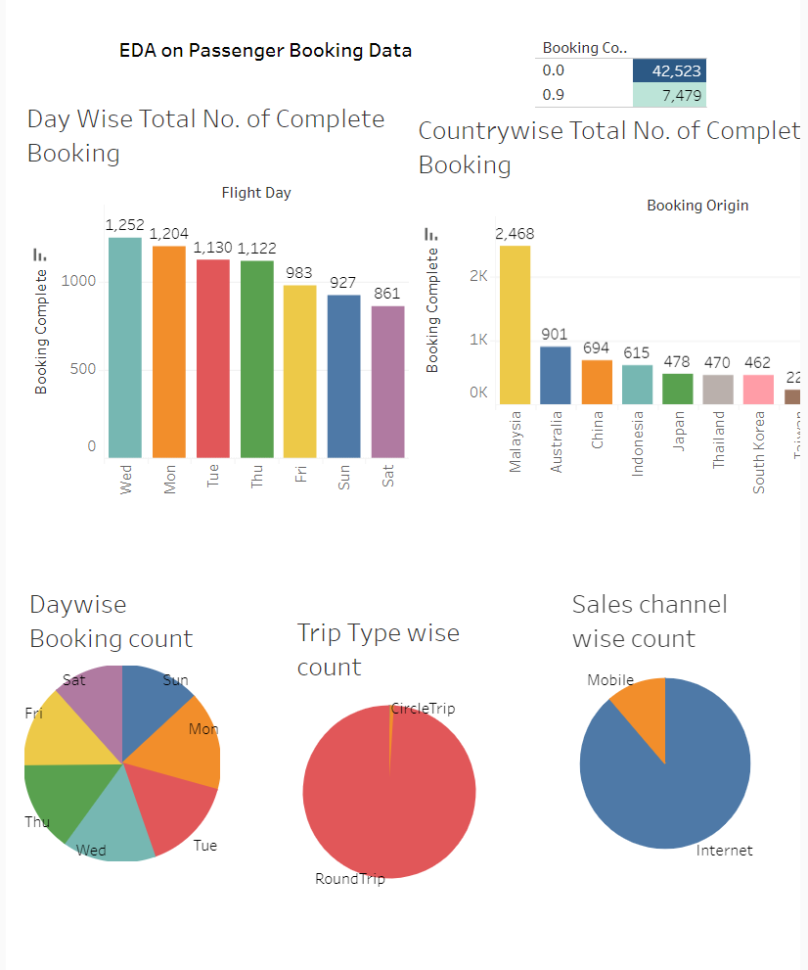
https://public.tableau.com/app/profile/kiran.phondake/viz/EDAonPassengerBookingData/Dashboard1?publish=yes
EDA: Tableau Dashboard

Slide 11
Thank You

